Slide 1
Restaurant Review Rating Prediction
Multiclass Classification Using Spark MLlib
Boris Korotkov
SCS-3252-008

Slide 2


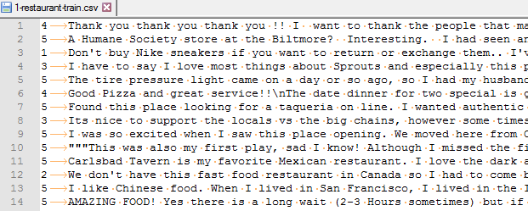
Objective
Predict Review Rating
Data
82, 065
records
Notes:
Topic selection rational
Data quality checks

Slide 3


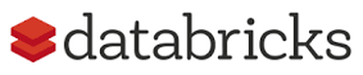
Feature Engineering
Tokenizer
StopWordsRemover
HashingTF
IDF (Inverse document frequency)

Slide 4

Model selection and training
80% Training / 20% Test
Random Forest Classifier
Cross Validation training
5 folds
2 parameters: Max Depth & NumTrees
Notes:
Rational of model selection and parameters selection

Slide 5

Model evaluation
MulticlassClassificationEvaluator
The accuracy on Test set is 35.08%
Improvement opportunities
Additional feature engineering
Different models
Advanced hyperparameter tuning
Notes:
n-gram, Word2Vec or with third party libraries (e.g. Spark NLP).
Multilayer perceptron classifier (MLPC) and Naive Bayes

Slide 6


